Slide 1
What’s Out There?
Accelerate Programme for Scientific Discovery

Slide 2
The story so far…
In this study group, we have looked at…
Introduction to diffusion models
Inspiration from physics
Probability distributions
VAEs
DDPM
Classifier-free guidance
Stable Diffusion
U-Net
CLIP
Applications
Early generative models
Computer vision applications
Other applications
Evaluation
Evaluating SD-like models
Other evaluation metrics

Slide 3
Today…
Today we will cover…
Ways to use open source diffusion models
Stable diffusion UIs
LoRas, checkpoints, VAEs
Hugging Face Diffusers
Additional information and questions

Slide 4
Stable Diffusion
Accelerate Programme for Scientific Discovery

Slide 5
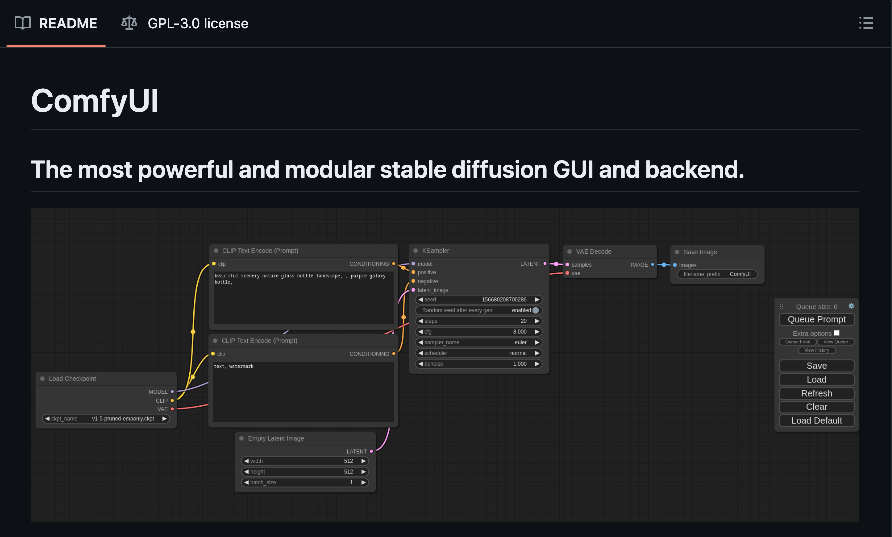



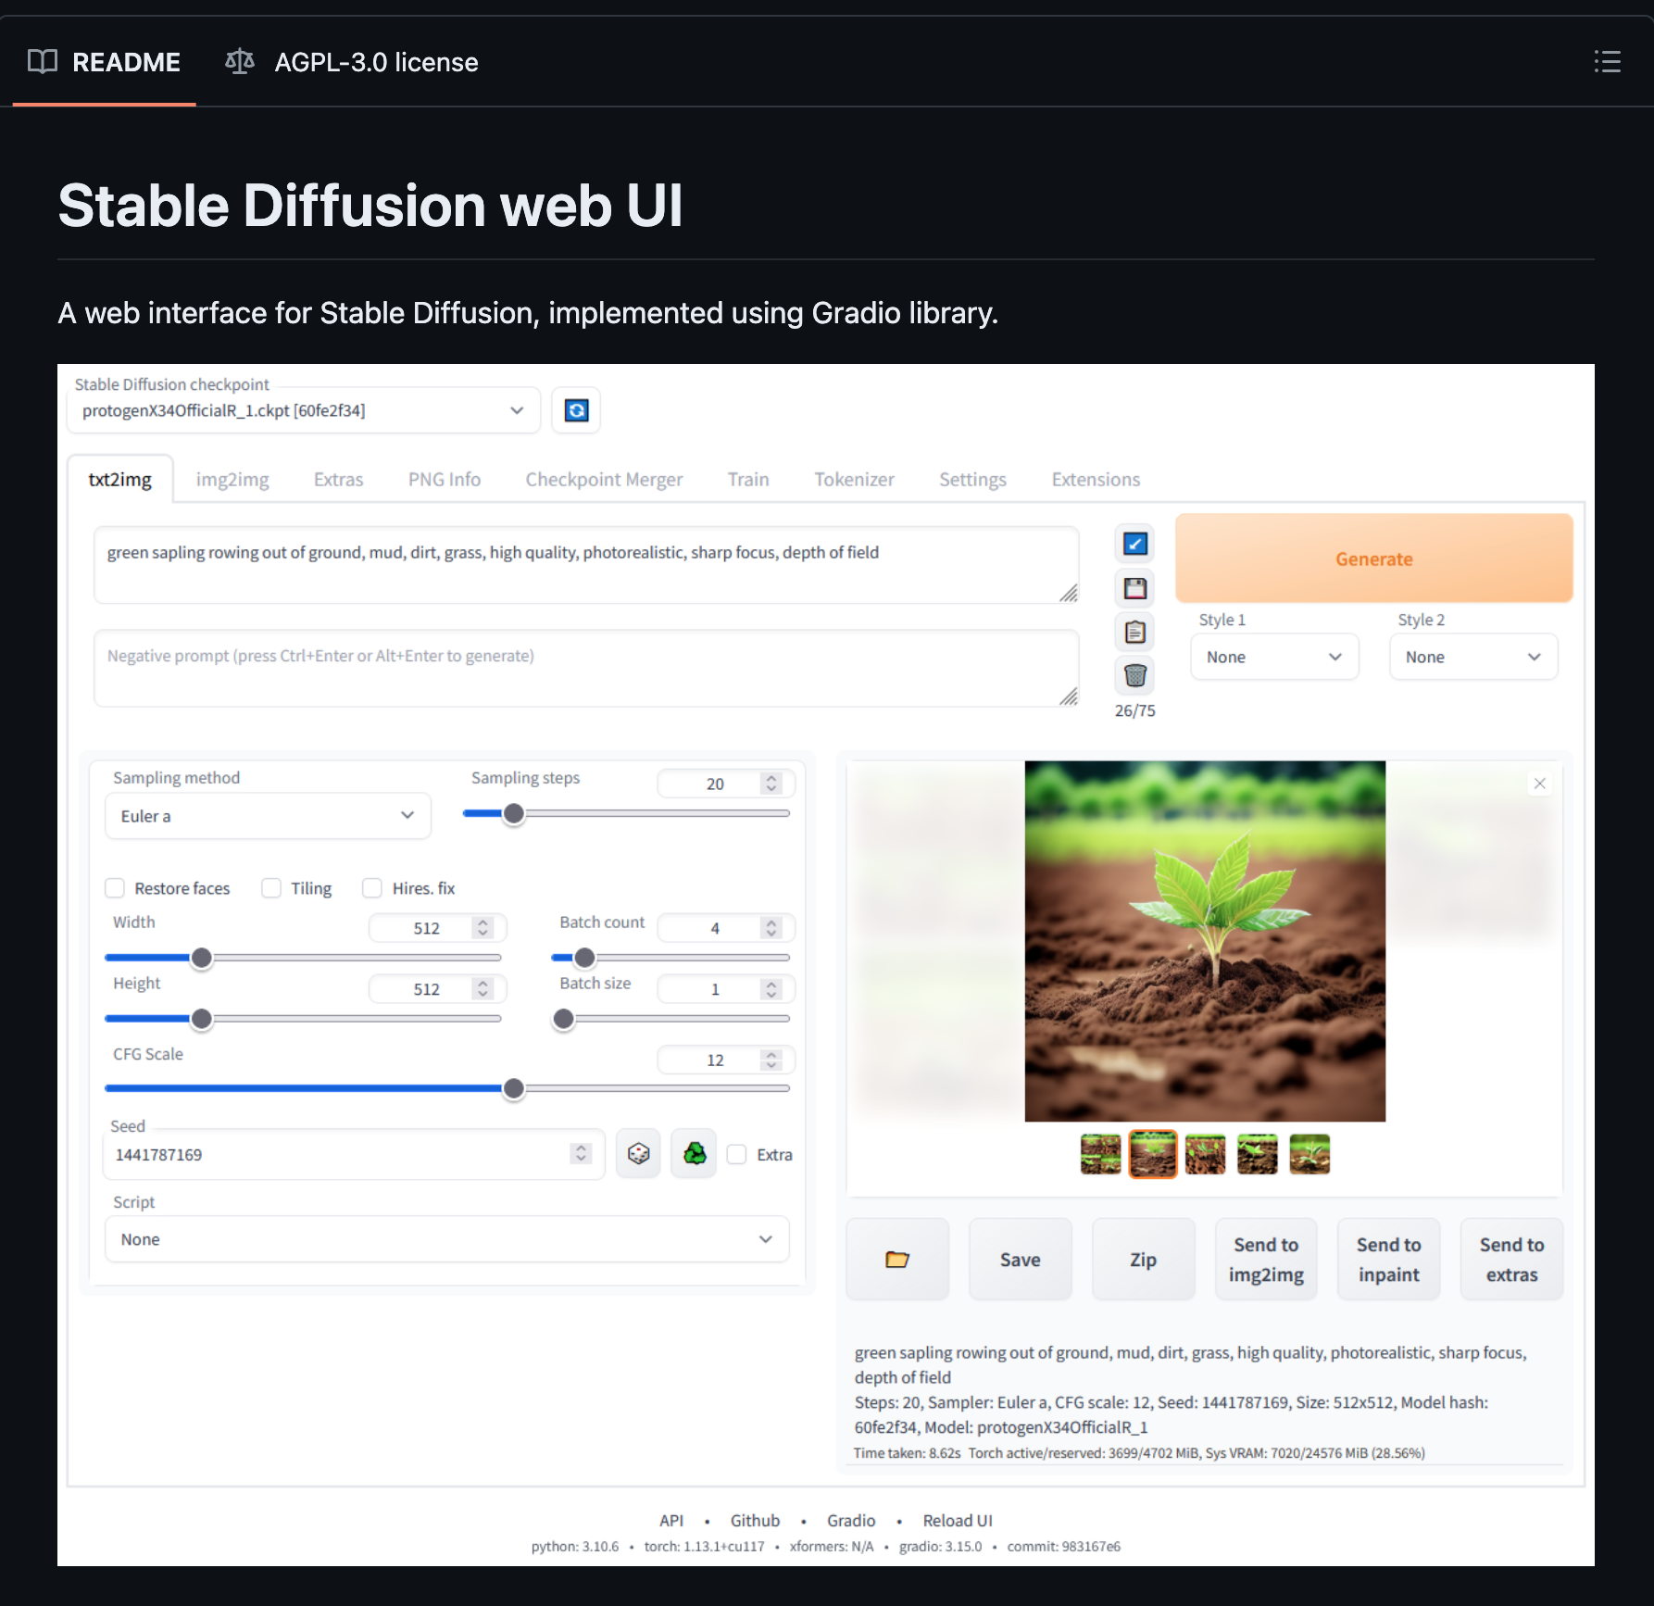

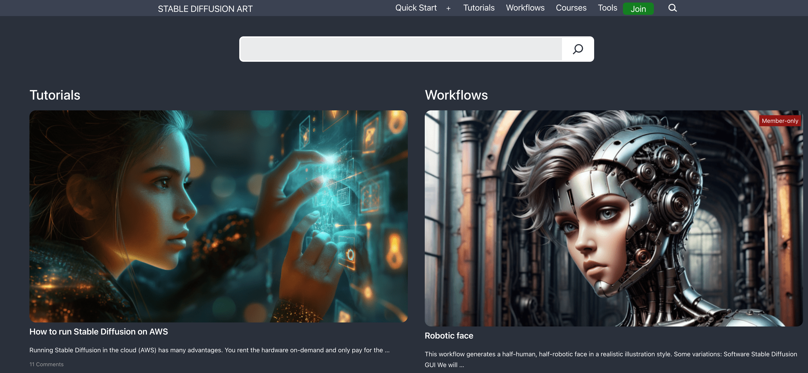


Stable Diffusion
Stable Diffusion highlights the power of open source
A rich and varied community has rallied around open source models…

